Slide 1
QA Hobby Project
Devin Patel

Slide 2
What it is
This project is for storing data for a bicycle event
It will be able to
Create
Add
Update
Delete
Riders from a database using a front-end web page. You will be able to either see all riders or search by team name.

Slide 3
Consultant Journey
For this project I have learnt the additional technologies from the previous project:
Spring, Axios, HTML, CSS, JavaScript (using VSCode), BootStrap.

Slide 4
CI
I have approached with the Dev-Feature branches, I have split my branches into functionality of backend, functionality of frontend, documentation, I have additionally created branches for testing that has not been completed and as a result is not merged back into the dev and main branch.

Slide 5
What was used?
Java and Spring for backend and connecting to database
SQL and H2 for databases for live and testing periods
HTML, JS, CSS (from an external library - BootStrap) for frontend, functionality, styling
JUnit for testing

Slide 6
Functionality
I will now perform a quick demonstration of the code in action (can be found at: https://github.com/D-Pats/QA-Hobby-Project)

Slide 7
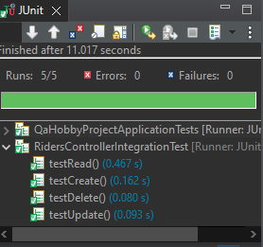
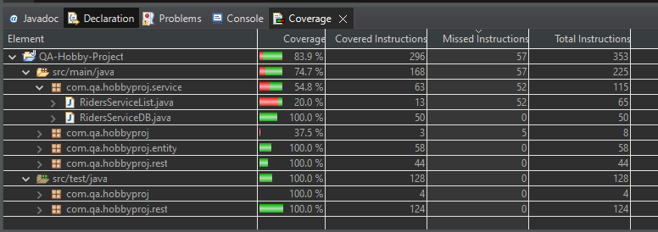
Coverage and Testing
As shown here Coverage has reached 83.9% as well as tests on the CRUD functionality all passing:
This can be increased by removing the ServiceList.Java file as it is not required after testing.

Slide 8
Documentation and Sprint Review
Documents can be found that include
MoSCow
Risk Assessment
ERD
UML
Jira Kanban board or User stories and workflow management.
https://devinpatel.atlassian.net/jira/software/projects/QHP/boards/4

Slide 9
Sprint Retrospective
What went well
Working frontend and backend with full CRUD functionality and additional search by team name feature
What could have been better
Upon reflection I could have learnt SonarQube for smells and included in my work, I could have also completed mockito testing however I was not able to do so.

